Slide 1
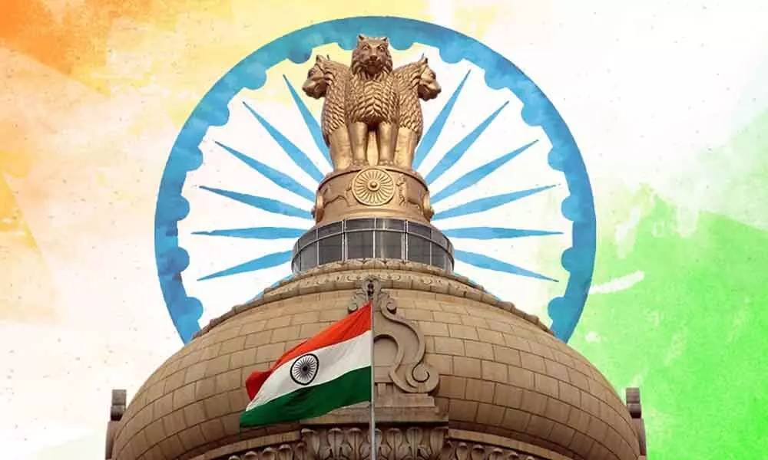

Slide 2




Meet our Team Members
Kanhaiya Lal Sahu
Prahlad Yadav
CH Shakish

Slide 3
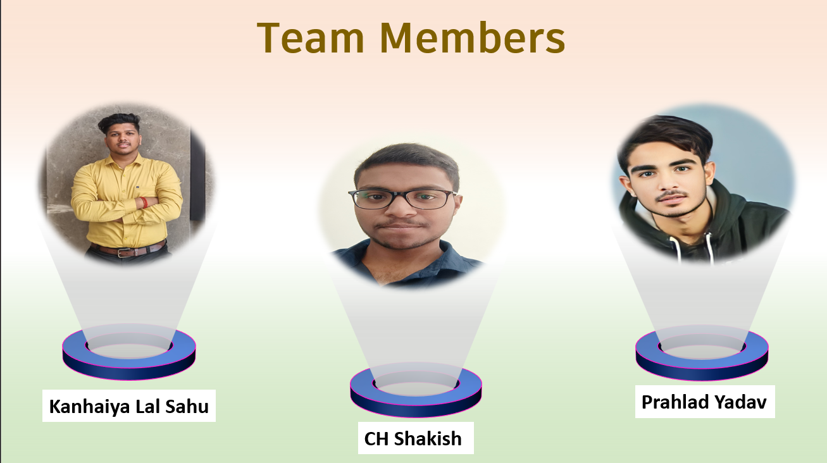

Slide 4

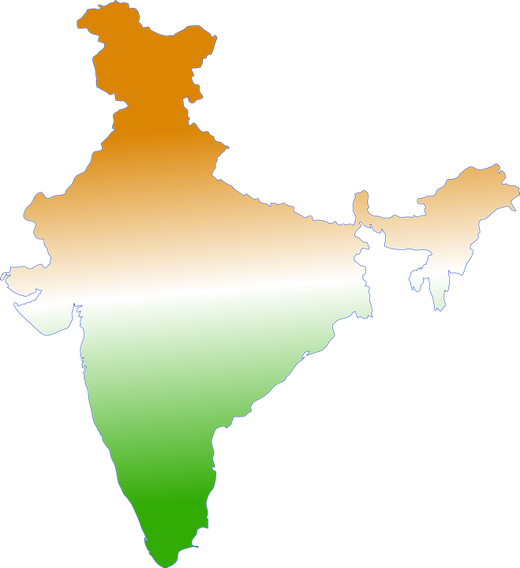
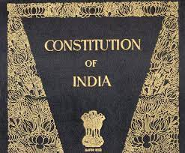
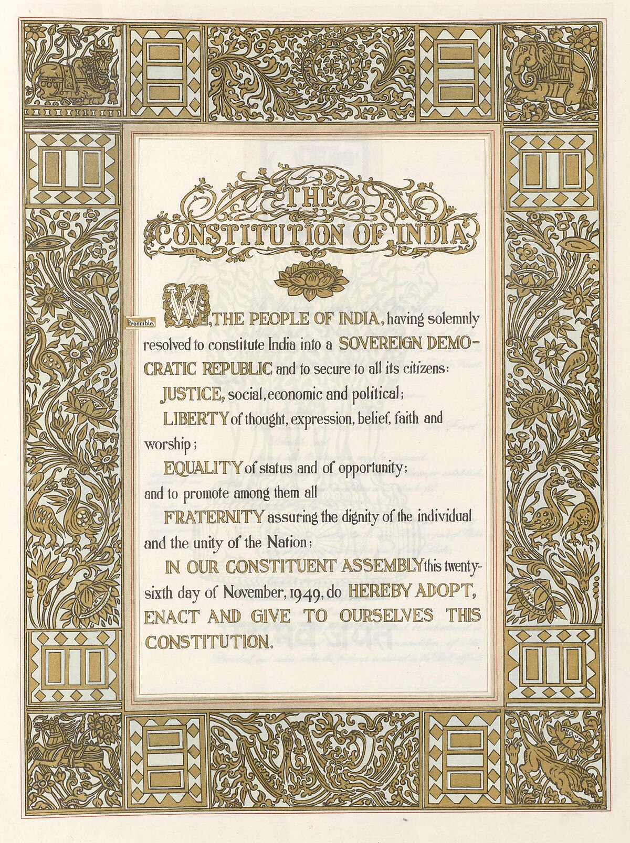
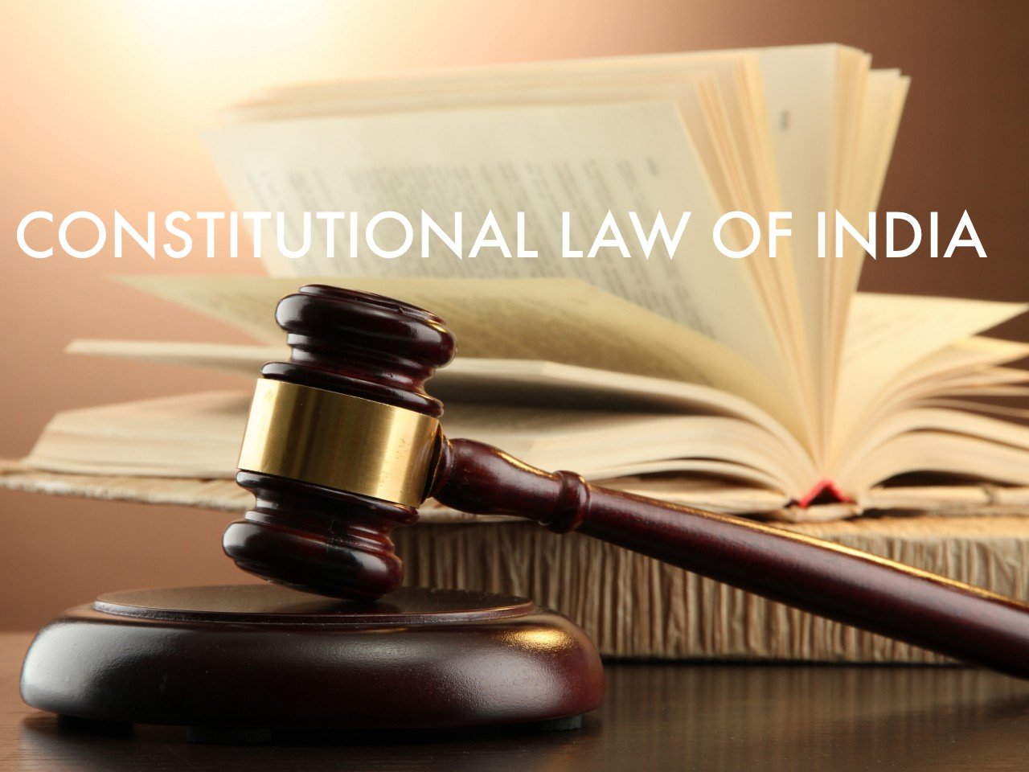
Constitutional Navigator:
Your Guide to Legal Rights and Governance

Slide 5

PROBLEM STATEMENT
Many Indian citizens are not aware about the laws in the Indian Constitution and their legal rights. They are also unaware about the various government policies and schemes. In case of any problem and other incidence they even don’t know what are their rights and at what sections they can file the case.
Despite living in democratic societies , millions of people don't know what rights they have, leading to unfair treatment and confusion in legal matters.
Fixing this is important, so that everyone can be treated fairly.

Slide 6

EXAMPLES
The RTE (Right to Education) Act, specifically Section 12(1)(c), was passed by the Indian Parliament on August 4, 2009, and became effective on April 1, 2010.
1
Right To Education
The Mahatma Gandhi National Rural Employment Guarantee Act (MGNREGA) is a landmark social security scheme enacted by the Indian government in 2005.
2
Minimum Wages
The various types of loans in India can be conveniently grouped as formal sector loans and informal sector loans.
3
Policies of Loan

Slide 7

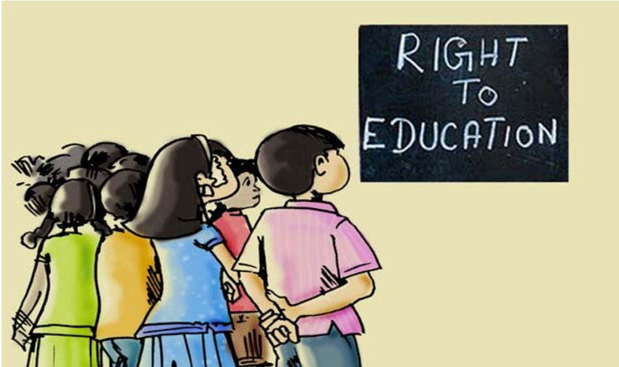


RIGHT TO EDUCATION
Every child has a right to full time elementary education of satisfactory and equitable quality in a formal school.
The benefits of RTE 12(1)(c) scheme have been implemented in Chhattisgarh since the academic year 2010-11.
Amendment at the state level in 2019 to extend its applicability from class VIII to class XII.
Under this scheme, 25% of seats in non-minority, non-aided private schools are reserved for children from economically weaker and disadvantaged backgrounds.
Children aged 3 to 6½ years are eligible for admission to any private school's elementary classes under this scheme. Students admitted through this scheme can study for free up to class XII in selected schools.

Slide 8
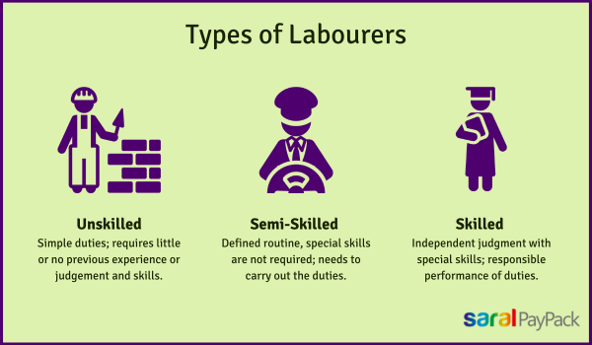


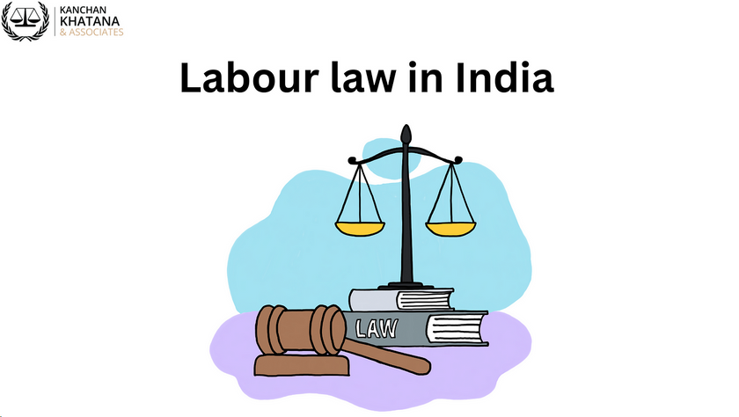
MINIMUM WAGES ACT
An Act to provide for fixing minimum rates of wages in certain employments.
Benefits are:
Protecting workers from exploitation, Ensuring a basic income, Reducing income inequality, Promoting economic stability, Setting labour standards, Addressing poverty
The minimum wage of Chhattisgarh is revised and made effective from 1st October 2023. The state of Chhattisgarh is divided into three zones:
Zone A- Areas within the limits of Raipur Municipal Corporation, Durg, Bhilai and Birgaon region.
Zone B- Areas of Rajnandangaon, Bilaspur, Korba, Raygarh, Ambikapur, Chirmir, and Dhamatri.
Zone C- Areas that are not included in Zones A and B.

Slide 9
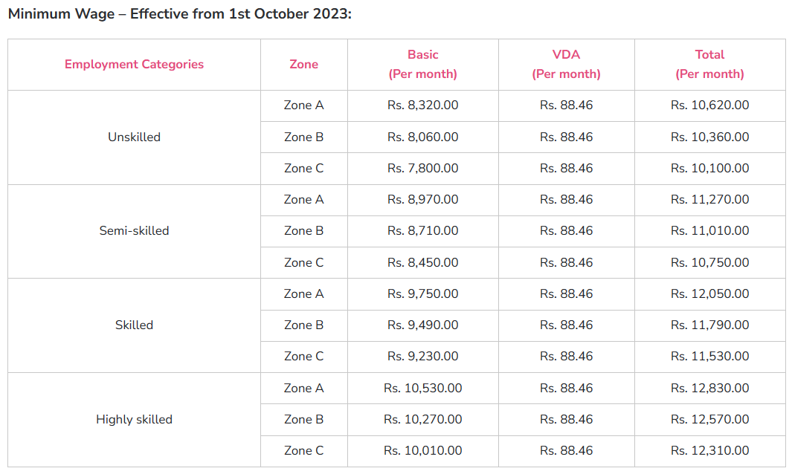
SOURCE: https://www.keka.com/library/minimum-wages/chhattisgarh

Slide 10
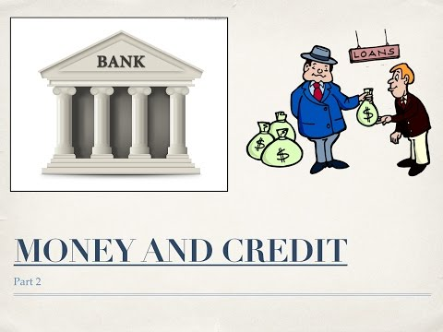
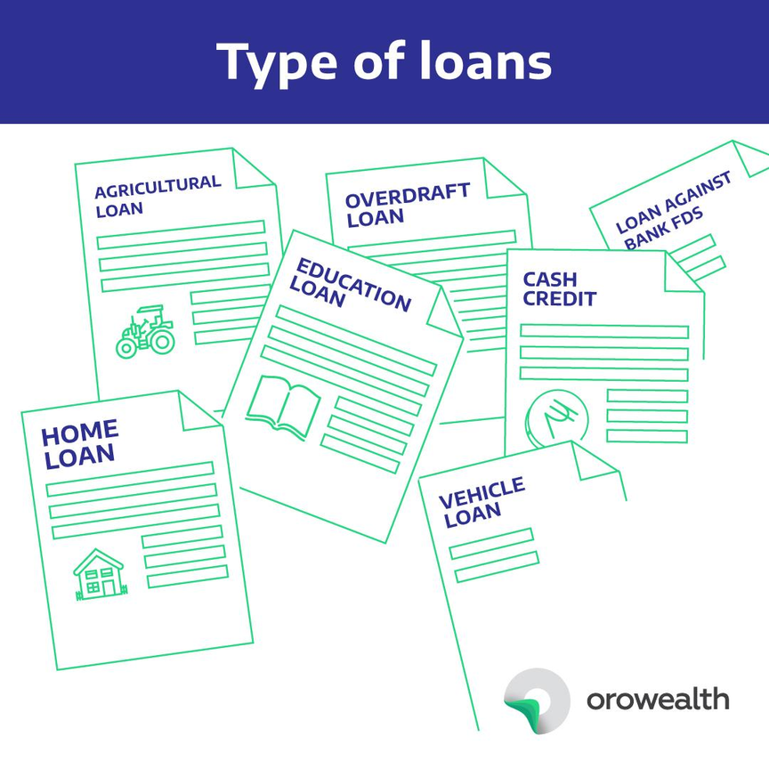

SECTORS OF LOAN
A loan is a sum of money that one or more individuals or companies borrow from banks or other financial institutions so as to financially manage planned or unplanned events.
The various types of loans in India can be conveniently grouped as formal sector loans and informal sector loans.
Informal Sector Loans
Moneylenders, traders, employers, relatives and friends, etc.
Lack of Regulatory Oversight and Supervision
Informal Lenders
Escaping the Grip of Debt Traps
Discouraging Entrepreneurship
Formal Sector Loans
These are loans from banks and cooperatives
Oversight and Regulatory Role
RBI’s Inclusive Lending Mandate
Banking Accountability

Slide 11

SOLUTION
CONSTITUTIONAL NAVIGATOR
YOUR GUIDE TO LEGAL RIGHTS AND GOVERNANCE

Slide 12
To aware citizens of India about the constitutional rights and the rules and regulations they should follow.
Our motive is to bring the Indian constitution to general people in simple and easy way by collaborating with Government of India(GoI).
To provide a wide base of community who have experienced the problems before same as you so that they can guide.
Our objective
From our website pepole can know about the various policies and schemes of government which are beneficial for them.
To get the knowledge about the various laws and the IPC sections in order to file the case against anyone.

Slide 13
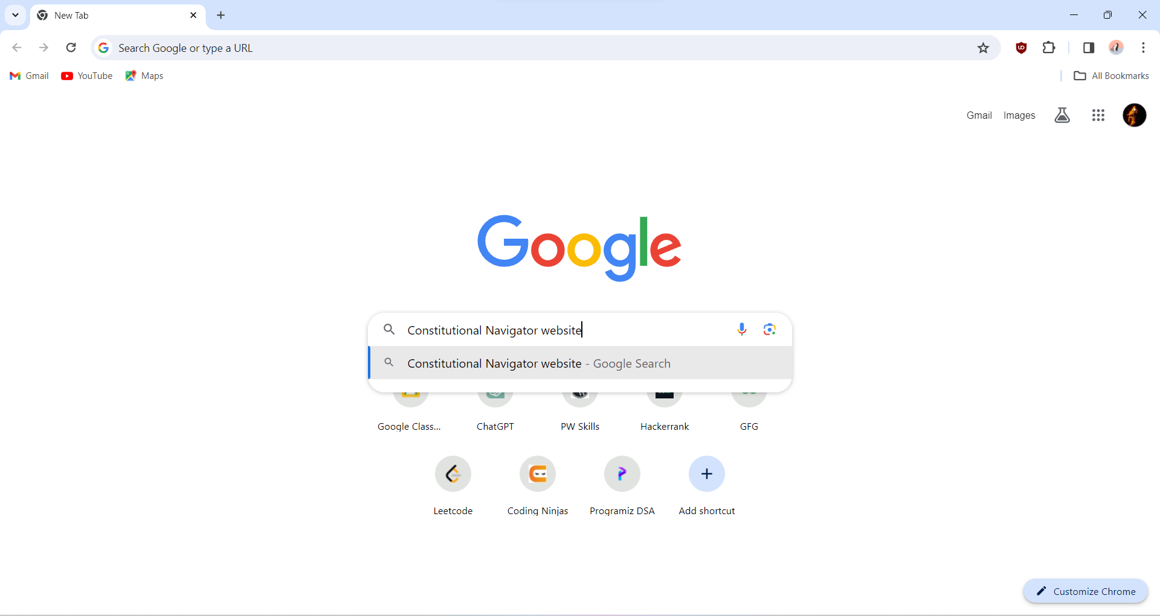
Let us walk you through our website

Slide 14
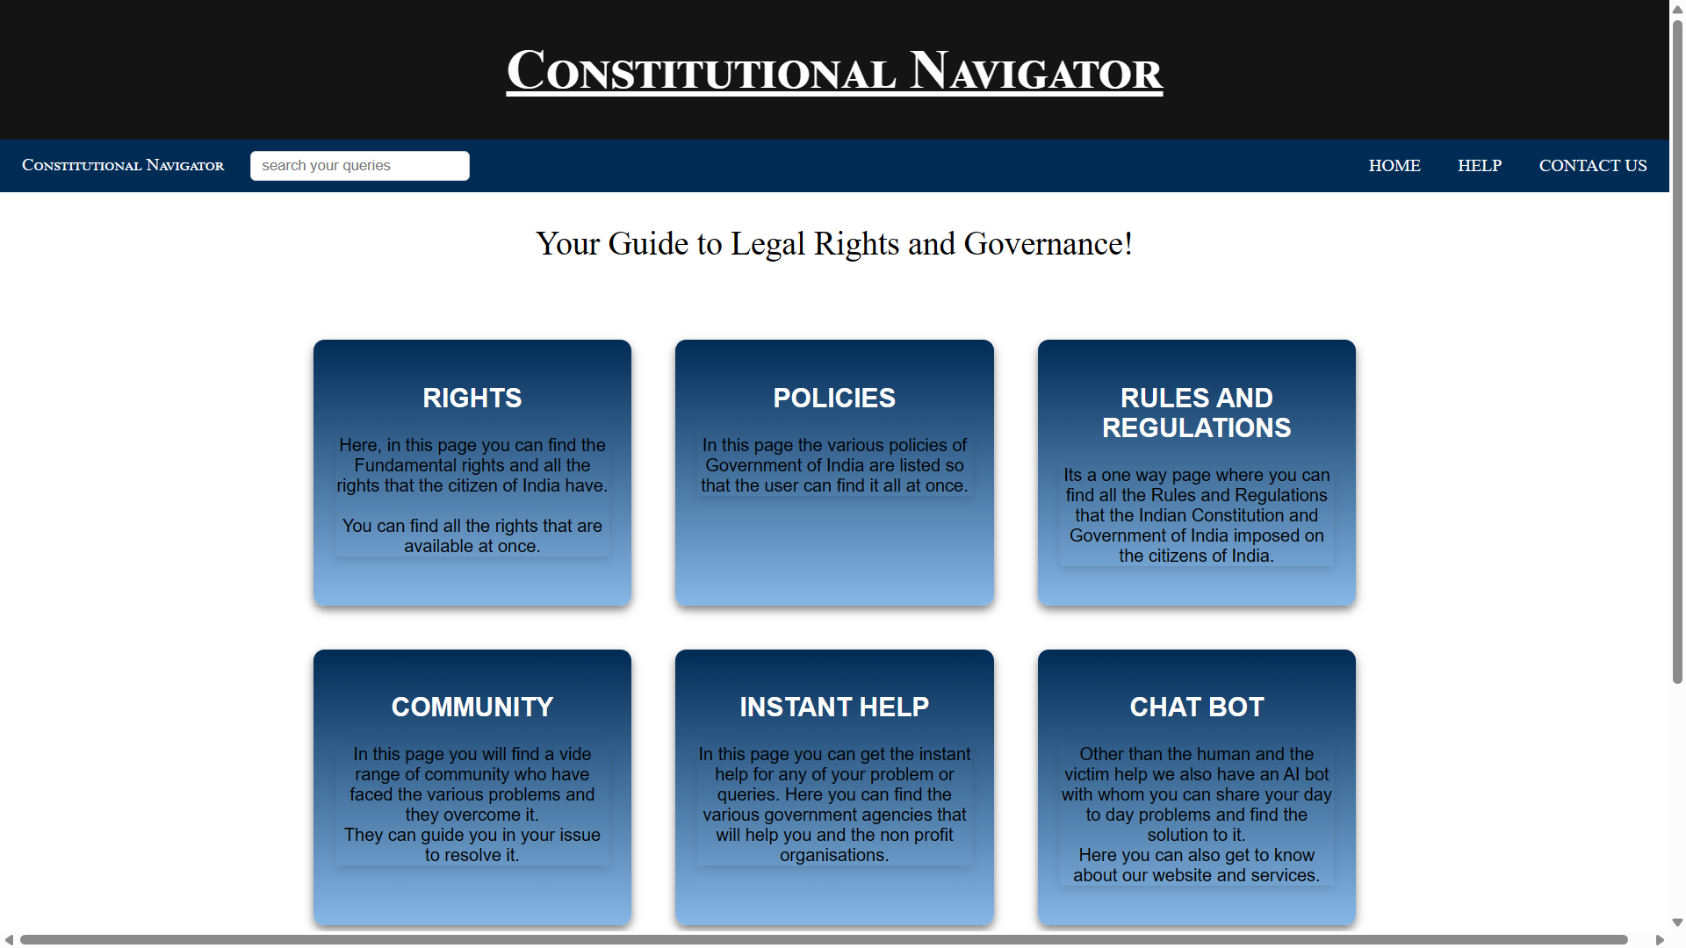
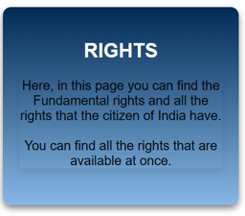
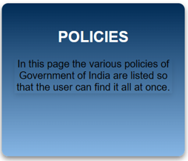
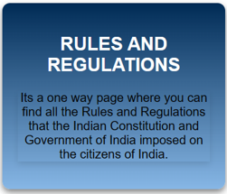
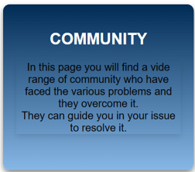
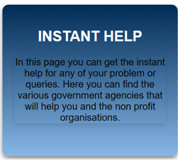


Slide 15
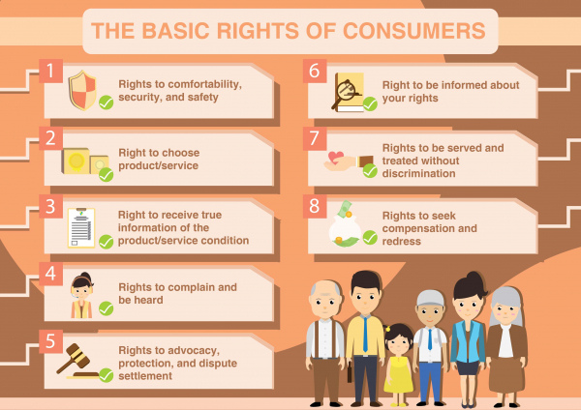
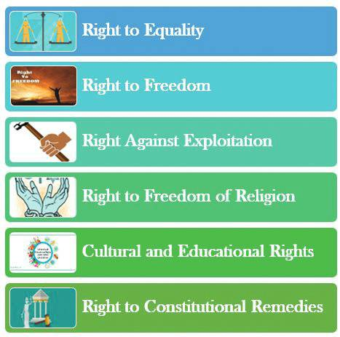
Rights
Fundamental Rights
< Back to Home Page

Slide 16
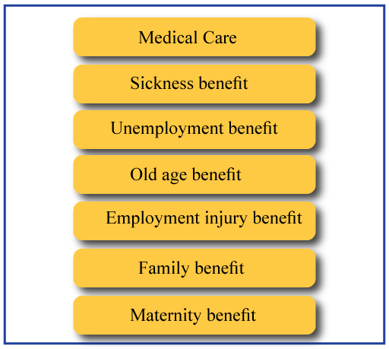
Policies
Policy on Adoption of Open Source Software for Government of India
National Policy for Farmers 2007 by Department of Agriculture and Farmers Welfare
National Policy on Education, 1968
Government Policy on Education
Mining Policy by Ministry of Mines
Delhi Transport Policy
Madhya Pradesh Sports Policy, 2005
National Policy on Narcotic Drugs and Psychotropic Substances
Himachal Pradesh Solar Power Policy
Jharkhand Animal Feed Processing Policy 2015
Information about New Agricultural Schemes of Arunachal Pradesh
< Back to Home Page

Slide 17

Rules and Regulations
< Back to Home Page

Slide 18








Community
Sheetal Verma
This website helped me a lot. I am able to resolve my issue regarding illegal construction in my land. If anyone is having any issues like this then feel free to contact me in this community page.
2
Yogesh Kumar
The chatbot feature helped me to get rid of my problem of being exploited by the wholesale sellers. If anyone is having any issues like this then feel free to contact me.
4
1
Nishant Sahu
I am able to know my roles and responsibilities through this website. And it provides a great knowledge of day to day policies released by the government.
< Back to Home Page

Slide 19
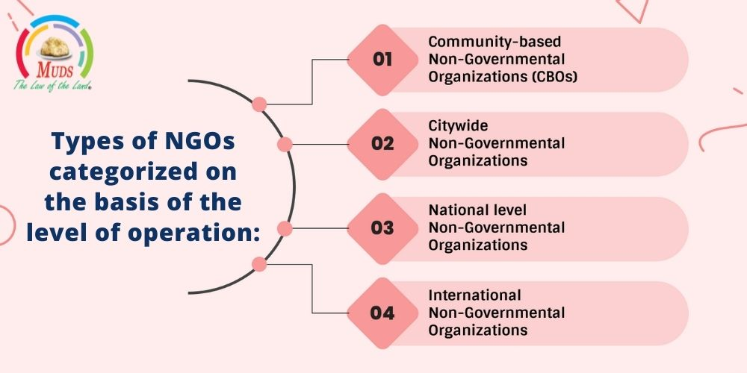

Instant Help
Emergency Phone numbers.
To get loans.
To connect with various NGOs and non-profit organizations.
< Back to Home Page

Slide 20


Chat Bot
< Back to Home Page

Slide 21



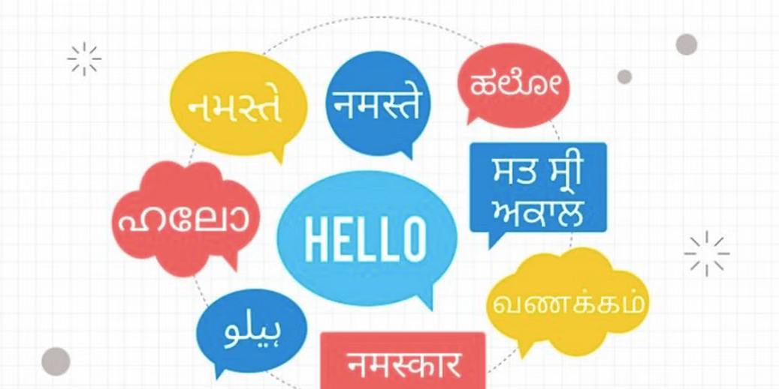
UPCOMING FEATURES
1
Scholarship
2
Voice Assistant
Regional Languages
3

Slide 22

THANK YOU
For being patiently hearing us.
ONE NATION
ONE WEBSITE
ONE SOLUTION
FOR HEARING US

Slide 23
RIGHTS
POLICIES
RULES AND REGULATIONS
Here, in this page you can find the Fundamental rights and all the rights that the citizen of India have. You can find all the rights that are available at once.
Its a one way page where you can find all the Rules and Regulations that the Indian Constitution and Government of India imposed on the citizens of India.
In this page the various policies of Government of India are listed so that the user can find it all at once.
COMMUNITY
INSTANT HELP
CHAT BOT
In this page you can get the instant help for any of your problem or queries. Here you can find the various government agencies that will help you and the non profit organizations.
Other than the human and the victim help we also have an AI bot with whom you can share your day to day problems and find the solution to it. Here you can also get to know about our website and serviceS.
In this page you will find a vide range of community who have faced the various problems and they overcome it. They can guide you in your issue to resolve it.

Slide 24
Team Members
Kanhaiya Lal Sahu
Prahlad Yadav
CH Shakish

